Slide 1

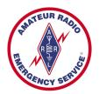
Training Volunteers
The ARRL
Introduction to Emergency Communication Course
EC-001 (2011)
Session Five
Notes:
Make sure you have modified the Name and Date.
Display this screen as students are arriving for class.

Slide 2
Reminder
Complete two DHS/FEMA Courses
IS-100.b Introduction to ICS
IS-700 National Incident Management System
Http://training.fema.gov/IS/NIMS.asp
Notes:
ARRL conditions!
The two ICS courses must be complete before taking the final exam.

Slide 3
Session Five Topic
Session 1 – Topics 1, 2, 3, 4, 5a, 5b
Session 2 – Topics 6, 7a, 7b, 7c, 7d, 8, 9, 10
Session 3 – Topics 11, 12, 13, 14, 15
Session 4 – Topics 16, 17, 18, 19, 20
Session 5 – Topics 21, 22, 23, 24, 25, 26, 27
Session 6 – Topics 28, 29, Summary, Final Exam
Notes:
The course requires a total of 18 hours.
If a student misses one class they can take a practice quiz for each lesson missed.
A student missing two sessions will be asked to take the course again.
A student missing the last session must wait for the next class and attend the final session for taking the exam again.
An exception would be two Field Examiners agreeing to give the exam at a mutually scheduled time.

Slide 4
Topic 21 – Operations & Logistics

Slide 5
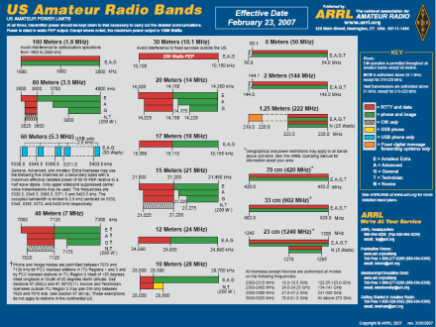
Phone Net Frequencies
Amateurs have a vast amount of radio spectrum
Most local and regional emcomm communication takes place on:
2 meter or 70 centimeter FM
40, 60, or 80 meter SSB/CW

Slide 6




Choosing Phone Net Frequencies
The choice made is based on the locations to be covered, the availability of repeaters, distance, terrain, and band conditions
VHF and UHF FM
Preferred for most local operations
Equipment is common
Portable
Clear voice quality
Coverage is extended by repeater stations
Larger areas or in areas without repeaters,
HF SSB may be needed

Slide 7
HF
Most local emcomm operation
40 or 80-meter bands
Near Vertical Incidence Skywave (NVIS)
Long-haul communication & international
15 or 20-meter nets

Slide 8
Know Your Resources
Many emcomm groups will have pre-selected a number of frequencies for specific purposes
Complete list of these frequencies should be in your jump kit
Become familiar with the coverage and features of repeaters and digital message systems in your area
Pre-program your radios with the frequencies, offsets, and CTCSS tones

Slide 9
Know Your Resources “In Advance”
Which repeaters are used for emergency communication in your area?
Will they be available for exclusive emcomm use, or must they be shared with other users?
How does it identify itself?
Are there any "dead spots" in critical areas? How much power is required to reach the repeater with a clear, quiet, signal from key locations?
Does the repeater have a courtesy tone, and what does it sound like? Do the tones change depending on the repeater's mode?
How long is the "time-out timer"?
Is it part of a linked system of repeaters? What features does it have, and which touch-tone commands or CTCSS tones activate them?

Slide 10
Know Your Resources “In Advance” (cont)
Net frequencies that support digital communication systems, such as packet radio bulletin board messaging systems, AMTOR, PSK31 and RTTY:
Which software do they use? ARESPACK, Fnpack, FNpsk?
Do the digital systems have mailboxes or digipeater functions?
Which other nodes can they connect to? Can traffic be passed over an Internet link automatically or manually?
How many connections can they support at once?

Slide 11
Network Coverage Concerns
Emcomm managers rely on simplex operation when planning their VHF or UHF FM nets
Repeaters often do not survive disasters or are overwhelmed with the amount of traffic
Simplex range is limited by
Terrain
Output power
Antenna gain
Height
Operation over a wide area can be a challenge

Slide 12

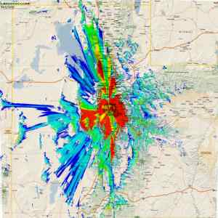

VHF and UHF Range
Terrain
Repeater Coverage
Antenna Height

Slide 13
Avoid Last Minute Surprises
Pre-test all known fixed locations in your area for coverage
If you are serving the Red Cross, test simplex coverage from each official shelter to the Red Cross office and the city's EOC or other key locations, and mobile coverage in the same areas

Slide 14
Improving Simplex Range
Use an antenna with greater gain
Move the antenna away from obstructions
Use a directional antenna
Increase antenna height
Increase transmitter output power as a last resort
Notes:
In a fast moving situation with poor simplex coverage and no repeater, it can be helpful to place a mobile station on a hilltop or office building where they can communicate with, and relay for, any station in the net. A mobile relay station can also allow communications to follow a moving event, such a wildfire or flash flood. That station becomes, in effect, a "human repeater". Although an expedient "work-around", this is a slow and cumbersome process that can reduce net efficiency by more than half. A modern aid to this kind of operation is the "simplex repeater". This device automatically records a transmission, and immediately re-transmits it on the same frequency. Remember that FCC rules do not allow unattended operation of simplex repeaters, and that you must manually identify it

Slide 15


Portable Duplex Repeater
Quickly deployed at a high point in the desired coverage area
Just has to reach and hear the stations in your net
Back seat of a car, using a mobile antenna, and parked on a ridge or even the top floor of a parking garage
Portable masts and trailer-mounted towers

Slide 16
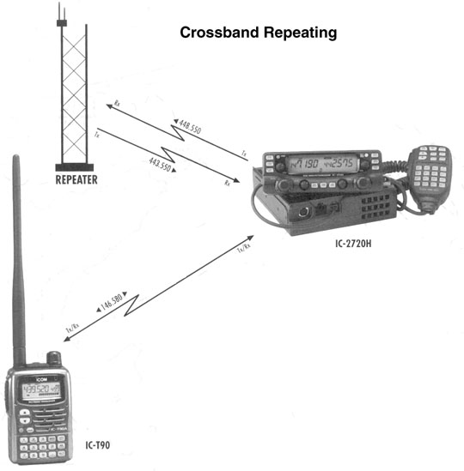
Cross Band Repeat
Dual-band radios
Mobile can relay your transmission to a repeater for even greater range
Use low or medium power setting to avoid overheating and damage
Consider using a fan to further reduce the likelihood that your radio will be damaged from overheating.

Slide 17
Frequency and Net Resource Management
Actual practice our choices are limited to the available operators and their equipment
Net managers may occasionally need to "shift" resources to meet changing needs
Early stages of an emergency => tactical nets may require more operators
Later stages => health and welfare traffic might increase

Slide 18



Message Relays
Third station "relay" the messages
Unable to communicate
directly
Move the stations involved off the main net frequency
to avoid tying up the channel for an extended period

Slide 19
Radio Room Security
Allow only the operators who are on duty to be in the room
Protect your equipment
Protect messages you handle
Prevent unnecessary distractions
Avoid leaving the radio room and equipment unattended and accessible
Don’t allow members of the press to be in the room without specific permission from the served agency

Slide 20
Record Keeping
Most served agencies will expect you to keep records of your operations
Original copies of any messages sent
Station logs
Memos
Official correspondence
Some may even require you to keep "scratch" notes and informal logs
Keep these records in your own possession for a time, or to turn some or all records over to the agency at the end of operations
What about records that are on a computer?
Know your agency’s policy in advance

Slide 21
Record Keeping
In some agencies, your station records are permanent and important legal documents, and must be treated as such
Know your served agency's policy on record keeping in advance so that you can comply from the very beginning of operations

Slide 22
Record Keeping
Station operating logs should contain:
Your arrival and departure times
Times you check in and out of specific nets
Each message, by number, sender, addressee, and other handling stations
Critical events -- damage, power loss, injuries, earth tremors, other emergencies
Staff changes -- both emcomm and site management, if known
Equipment problems and issues

Slide 23
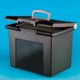
Record Keeping
Every individual message or note should be labeled with a time and date
Scratch notes
Place dates and times next to each note on a sheet, so that information can be use later to determine a course of events
“Portable office" type file box, expanding file, or any other suitable container can be used to organize and file the messages

Slide 24
Dealing With Stress
Most people are not used to working under extreme stress for long periods, and do not know how to handle it
Nervous breakdowns are common among those who get overwhelmed
Have not learned to manage stress and stress-causing situations
Unable to make
good decisions
Disoriented
Lose temper
Behave in ways
you never would
any other time
Unable to make
any decision
Confused

Slide 25
Dealing With Stress
Tendency is to regard every situation or need as an "emergency," requiring an immediate response
You might get a barrage of requests for action
You might not have the extra seconds it requires to fully consider the options, and to prioritize your actions
The result is an overload of responsibility, which can lead to unmanageable levels of stress

Slide 26
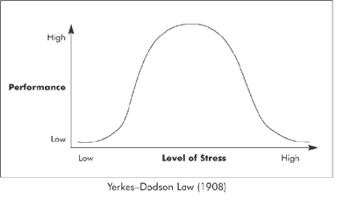
Dealing With Stress
You cannot eliminate disaster-related stress
You can certainly take steps to reduce or control it

Slide 27
Case Example 21-1
In a recent activation, an after action report commented on how one Amateur Radio Operator supporting an EOC worked for 36 hours straight. He was praised for his dedication.
Discussion
What is good about this?
What are the problems with this?
How would you have handled this situation?
If you were this operator
If you were the EMCOMM manager for this operator

Slide 28
Case Example 21-2
In a recent exercise debriefing, an Amateur Radio Operator said that in the event of an earthquake if he was assigned second shift at the EOC, he would not stand idle waiting for his shift. He would assist in other ways in the community and then proceed to work his 12 hour EOC shift.
Discussion
What is good about this?
What are the problems with this?
How would you do awaiting the start of your EOC shift?

Slide 29
Dealing with Big Egos
Some within the emergency response community have "big egos“
Others with a need to be in full control at all times
Take time now to consider how you will respond to the challenges they present

Slide 30
Dealing with Big Egos
Come up with a different and more positive response strategy => not anger
Depending on the official position of the "problem" person, you might:
Do your job as best you can, and deal with it after the emergency is over
Politely decline and state your reasons
Refer the issue to a superior
Choose in advance to volunteer in another capacity and avoid that person altogether

Slide 31
Stress Management Tips
Delegate some of your responsibilities to others. Take on those tasks only you can handle.
Prioritize your actions --the most important and time-sensitive ones come first.
Do not take comments personally -- mentally translate "personal attacks" into "constructive criticism" and a signal that there may be an important need that is being overlooked.
Take a few deep breaths and relax. Do this often, especially if you feel stress increasing. Gather your thoughts, and move on.
Watch out for your own needs -- food, rest, water, medical attention.

Slide 32
Stress Management Tips
Do not insist on working more than your assigned shift if others can take over
Get rest when you can so that you will be ready to handle your job more effectively later on
Take a moment to think before responding to a stress-causing challenge -- if needed, tell them you will be back to them in a few minutes
If you are losing control of a situation, bring someone else in to assist or notify a superior
Do not let a problem get out of hand before asking for help
Keep an eye on other team members, and help them reduce stress when possible

Slide 33
Long Term Operations
Additional operators to allow for regular shift changes, and those who go home
Replacement equipment, as operators leave with their own gear or it fails
Food and water
Suitable place to sleep or rest
Generator fuel
Fresh batteries
Sanitation facilities
Shelter
Message handling supplies, forms
Alternate NCS operators, backups
Additional net resources to handle message traffic

Slide 34
Battery Management
You will eventually need to recharge your batteries
Some batteries need more time to recharge than others
This time needs to be taken into account in your planning
Slow-charging batteries
May need to have enough on-hand to last the entire length of the operation

Slide 35
Battery Management
Deep cycle marine batteries can require a full day or longer to fully recharge
Sealed lead-acid (SLA) batteries, also known as "gel-cells", require up to 18 hours to recharge depending on the size of the battery
NiCd, LIon, and similar batteries can be recharged quite quickly
Repeated rapid charge cycles can reduce overall battery life

Slide 36

Generator and Power Safety
Placement of generators
Engine noise
Difficult for shelter residents and volunteers to get much needed rest, and for anyone trying to do their job
Exhaust fumes
Should not be allowed to enter the building or nearby tents or vehicles
"down-wind" of any occupied location is best
Notes:
Even when vehicles are not included, internal combustion engines are still the number one cause of carbon monoxide poisoning in the United States. Propane powered engines produce as much or more CO as gasoline or diesel engines.

Slide 37
Generator and Power Safety
Earth Grounding
Not required as long as only plug and cord connected equipment is used, and the generator meets National Electrical Code (NEC) standards listed in Article 250-6
Exception is for generators that will be connected, even temporarily, to a building's permanent electrical system.
For further details on grounding AC electrical systems, please refer to Article 250 of the NEC
Primary hazards to avoid when using a generator are carbon monoxide (CO) poisoning from the toxic engine exhaust, electric shock or electrocution, and fire.
Follow the directions supplied with the generator.
Every year, people die in incidents related to portable generator use.

Slide 38
Generator Safety Policy
Generator Placement
Generators are placed in an area off limits to unauthorized persons and children.
Generator is dry and not used in rain or wet conditions. Generator is operating on a dry surface under an open canopy-like structure, such as under a tarp held up on poles.
Generator is operating outdoors in a well-ventilated dry area.
Generator is operating away from air intakes to any structure.
All operators are using dry hands before touching the generator.
Generator Grounding
Generator is grounded using a ground rod and large gauge wire (AWG 8 or larger) to bond the generator frame to ground. OR
Generator is properly grounded per the manufacturer’s manual.
Wiring
Generator is not connected directly to existing wiring (avoid back feeding system).
Individual devices are connected directly to the receptacle outlet of the generator or via approved extension cord.

Slide 39
Generator Safety Policy
Extension Cords are
Outdoor rated
Of sufficient gauge and length to handle electrical loads without daisy-chaining
Free of cuts or tears and cracked housings.
Have three conductors and plugs have all three prongs.
Routed to prevent tripping hazard.
Generator Capacity
Loads are less than the output rating of the generator.
Manufacturer’s Instructions
A copy of the generator’s operating manual is available at the generator site.
Operation is consistent with all instructions in generator's owner manual.

Slide 40
Generator Safety Policy
Fuel Storage
Fuel is stored outdoors.
Fuel is stored in properly labeled, non-glass safety containers.
Fully charged, approved fire extinguisher is located near the generator.
Refueling
Generator is off and cool before refueling.
Shutdown
All equipment is turned off before shutting down generator.
Burn Hazard
Exposed mufflers and other hot parts are protected and labeled.

Slide 41

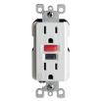

Ground Fault Interrupters (GFIs)
GFIs detect any difference between the currents flowing on the hot and neutral conductors, and opens the circuit
Test any GFI device to be used with or near HF radios to be sure that the GFI will function properly while the radio is transmitting.

Slide 42
AC Extension Cords
Should be rated for the actual load
Consider radios, lights, chargers, and other accessories when calculating the total load
Extension cords are rated only for their actual length
Cannot be strung together to make a longer cord without "de-rating" the cord's capacity
A typical 16ga, 50' orange "hardware store" cord is rated for 10 amps. When two are used to run 100', the rating drops to only 7 amps

Slide 43

AC Extension Cords
Choose a single length of cord rated for the load and the entire distance you must run it.
If this is not possible, you can also run two or more parallel cords to the generator in order to reduce the load on any single cord.
For more information on portable power cord requirements, consult Article 400 of the NEC.

Slide 44

What About Using "Romex ™"
"Romex ™" type wire for long extension cords
Violation of the National Electrical Code
Dangerous practice
Repeated bending, rolling, and abrasion cause the copper conductors and insulation to break, resulting in a fire and electrocution hazard
Use only flexible insulated
extension cords that are UL rated
for temporary, portable use

Slide 45
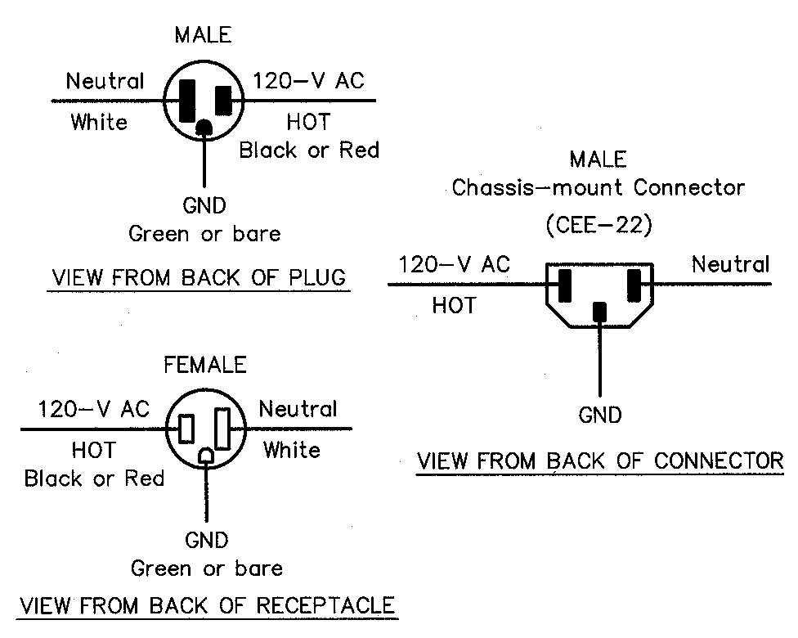
Electrical Safety Guidelines
Electrical codes require three-wire power cords and plugs on many tools and appliances.
The “hot” wire is usually black.
The “neutral” wire is usually white.
The frame/ground wire is usually green or bare wire.
Do not install higher current capacity fuses in an existing circuit.

Slide 46
Ground Everything
For best protection from electrical shock all equipment should be connected to a common ground.

Slide 47
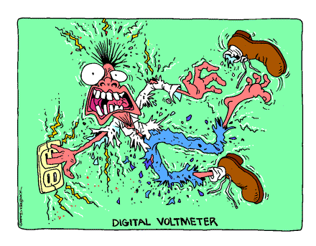

Slide 48
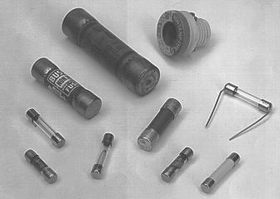
The Fuse
A fuse or circuit breaker should always be added in series with home built equipment that is powered from 110 volt AC lines.
In a 12 volt DC system fuses should be located at the voltage source.
When a fuse blows an open circuit is created.
Never replace a blown fuse with a higher amperage rated fuse.

Slide 49
Electrical and RF Safety
Fuses and circuit breakers
The purpose of a fuse in an electrical circuit is to interrupt power in case of overload.
If you install a 20-ampere fuse in your transceiver in the place of a 5-ampere fuse excessive current could cause a fire. (Note: If it didn’t cause a fire, it still could result in damage to the equipment.)
Grounding
Ground is connected to the green wire in a three-wire electrical plug.

Slide 50

Electrical and RF Safety
Lightning protection
The precautions that should be taken when a lightning storm is expected are:
Disconnect the antenna cables from your station and move them away from your radio equipment
Unplug all power cords from AC outlets
Stop using your radio equipment and move to another room until the storm passes
All of these answers are correct
Fire prevention is the most important reason to have a lightning protection system for your amateur radio station.
GET OFF THE AIR DURING SEVERE STORMS!!

Slide 51
RF Safety
Ensure that all stations comply with the FCC requirements for maximum permissible exposure to RF radiation.
No person should be near any transmitting antenna while it is in use.
Make certain that the RF radiation is confined to the antennas' radiating elements.
Don't operate high-power amplifiers with the covers removed.
With hand-held transceivers, keep the antenna away from your head and use the lowest power possible.
Don't work on antennas that have RF power applied.
Don't stand or sit close to a power supply when the ac power is on.
Never look into a waveguide or directive UHF/SHF antenna when power may be applied.

Slide 52
RF Safety
Even though hand-held radios are exempt from RF exposure limits, minimum power should be used with a hand-held to minimize RF exposure to the operator's head (eyes)
A mobile transceiver with roof mounted antenna would have better shielding for the vehicle occupants than using a hand-held transceiver in a vehicle

Slide 53
Equipment -- Leaving Yours Behind?
You are exhausted, and ready to head for home, but the emcomm operation is far from over.
You brought along a complete station, and when you leave, the next operator is not nearly as well equipped.
Should you leave your equipment behind for the next operator?

Slide 54
Equipment -- Leaving Yours Behind?
No one can, or should, tell you to leave your equipment behind
If you feel comfortable that someone you know and trust will look after your gear, you may choose to leave some or all of it behind
Be sure every piece is marked with at least your name and call sign
Do not leave behind anything the next operator does not truly need
You still have the ultimate responsibility
for its operation and safety

Slide 55
Equipment -- Leaving Yours Behind?
Emergency stations are difficult places to control and monitor.
If your equipment is stolen, lost, or damaged, you should not hold anyone responsible but yourself.
Conversely, if someone leaves their equipment in your care, treat and protect it better than you would your own, and be sure it is returned safely to its owner.

Slide 56
Accepting Specialized Assignments
You may be asked to handle other assignments for the served agency that may or may not include communicating
At one time, most emcomm groups had strict policies against doing other tasks
This is still true of some
Today, most emcomm groups will permit their members to be cross-trained for, and perform, a variety of served-agency skills that also include communicating

Slide 57
Summary
Any questions before the quiz?

Slide 58
Time for a Quiz
Take 30 Seconds adjust your workspace

Slide 59
30
Seconds

Slide 60
20
Seconds

Slide 61
10
Seconds

Slide 62
9
Seconds

Slide 63
8
Seconds

Slide 64
7
Seconds

Slide 65
6
Seconds

Slide 66
5
Seconds

Slide 67
4
Seconds

Slide 68
3
Seconds

Slide 69
2
Seconds

Slide 70
1
Seconds

Slide 71
Let's get started!

Slide 72
Topic 21 Question
Which of the following will NOT limit VHF simplex range?
Terrain
Output Power
Antenna Gain
Digipeaters

Slide 73
Topic 21 Question
Which of the following actions will NOT improve simplex reception?
Increase the antenna height
Switch to a (lower-gain) non-directional antenna
Increase transmitter output power at both stations
Move the antenna away from obstructions

Slide 74
Topic 21 Question
Which of the following is true about a simplex repeater?
The FCC rules do not permit unattended operation of simplex repeaters
They work best in the "cross band repeater" mode
They require the use of two radios
Is the same as a "human repeater"

Slide 75
Topic 21 Question
Which of the following is a good means of dealing with stress during an emcomm event?
Take every comment personally
Pay no attention to other team members; let them handle their own problems
To reduce personal stress, insist on working more than your own shift
Prioritize your actions - the most important and time sensitive ones come first

Slide 76
Any Questions Before Starting Topic 22?

